Slide 1


DEPARTMENT OF ELECTRICAL AND ELECTRONICS ENGINEERING
Seminar(18EES84)
on
Substation Protection Schemes and Performance Analysis
BY
DIVYA E R
4GW19EE011
Under the Guidance of
Dr. Raghavendraprasad Deshpande
Associate professor
Dept. of EEE

Slide 2
CONTENTS
INTRODUCTION
LITERATURE SURVEY
OBJECTIVES
METHODOLOGY
PROTECTION DEVICES
PROTECTIVE ZONES
CONCLUTION

Slide 3
INTRODUCTION
Protection system plays an important role in power network, to keep the network stable, it is necessary to have a reliable protection system.
Primary function of the protective system is to detect and isolate all failed or faulted components as quickly as possible, thereby minimizing the disruption to the remainder of the electric system.
The task of protection and control in substations and in power grids is the provision of all the technical means and facilities necessary for the optimal supervision, protection, control and management of all system components and equipment in high and medium-voltage power system
Protection system shall have factors like Reliability, selectivity, fault clearing time ,sensitivity If each of these factors is not satisfied, protection system fails.

Slide 4
LITERATURE SURVEY
Navinesshani Permal, Miszaina Osman and Azrul Mohd Ariffin “ Review of substation Grounding System Behavior Under High Frequency and Transient Faults in Uniform Soil” 2020.
Seyed Ahmad Hosseini “Anamysis of Substation protection System Failures and Reliability ” 2020
F.Wang , “Reliability Evaluation of Substation subject to Protection Failures,” Delft university of Technology 2018
Shantanu Kumar, Narottam Das and Syed Islam “Performance Analysis of Substation Automation Systems Architecture Based on IEC 61850 ”,2019

Slide 5
OBJECTIVES
Only the faulty part of the system is completely isolated within a minimum time so that the remaining system operates normally.
In the case of normal conditions, there should be no nuisance tripping

Slide 6
METHODOLOGY
TYPES OF SUBSTATION PROTECTION SCHEMES
Overcurrent Protection Scheme
Differential Protection Scheme
Distance Protection Scheme
Directional Protection Scheme

Slide 7
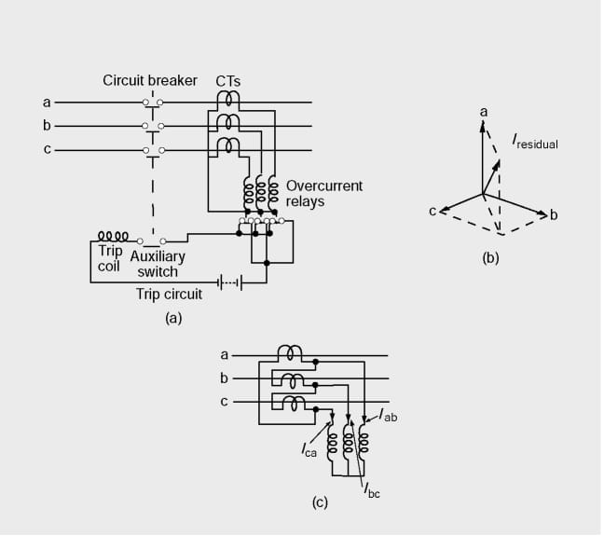
Overcurrent Protection Scheme
Overcurrent protection is the method of implementing hardware and other electrical components to limit or disable current flow. Fuses, circuit breakers, or fusible links are the most commonly used methods to provide overcurrent protection to a circuit .
Figure.Circuit diagram of simple overcurrent protection scheme, (a) CTs in star connection, (b) Phasor diagram of relay currents, star connection, (c) CTs in delta connection

Slide 8
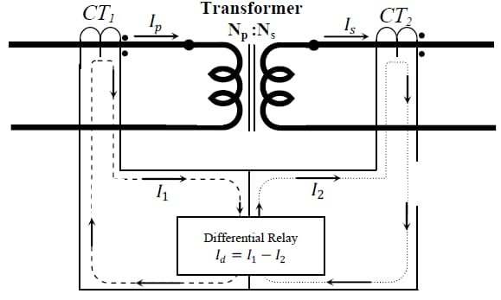
Differential Protection Scheme
Differential protection is one of the most widely used methods for protecting power transformer against internal faults. The technique is based on the measurement and comparison of currents at both side of transformer: primary and secondary lines
Figure.Differential protection for single phase two winding transformer

Slide 9
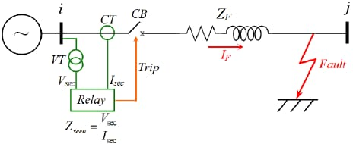
Distance Protection Scheme
Distance protection schemes are commonly employed for providing the primary or main protection and backup protection for AC transmission line and distribution line against three phase faults, phase-to-phase faults, and phase-to-ground faults.
Figure.Principle operation for distance protection

Slide 10
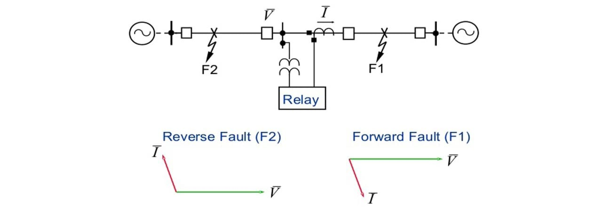
Directional Protection Scheme
Directional protection scheme becomes functional in the case of a double-end feed system or parallel lines or a ring main system, where a fault gets fed from both sides. From the selection perspective, this type of protection is sensitive enough to detect the direction of the fault power flow.
Figure.Principle of Directional Overcurrent Protection

Slide 11
PROTECTIVE DEVICES
Circuit breaker
Lightning arrester
Distribution transformer
Insulator
Busbar
AB switch
Capacitor bank
Earthing
Fencing
Distribution panel board

Slide 12
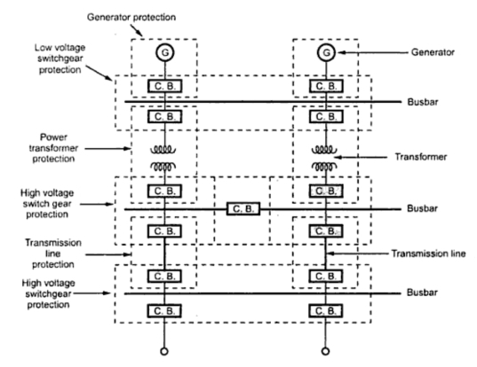
PROTECTION ZONES
Zones of protection is one strategy that can be used to provide the level of security demanded today. Protective relay engineers keep utility grids and equipment safe from faults and system unbalances by dividing the grid into zones, each with a unique protection scheme. Overlapping zones provide backup protection.

